Slide 1




Queuing models in OPDs/ availability of beds/ admission of patients. A hospital based solution is ideal which can be integrated with city wide module . (SIH -1620)
B.TECH 2022-26 6TH SEM
MINOR PROJECT-II

Slide 2
TABLE OF CONTENTS
1
TEAM
7
SCREENSHOT
2
INTRODUCTION
8
FUTURE SCOPE
3
OBJECTIVES & SCOPE
9
CONCLUSION
4
TECHNOLOGY STACK
5
FLOW CHART
6
ER DIAGRAM

Slide 3



OUR PROJECT
TEAM
ABHISEK PANDA 22CSE072
DEBABRATA MISHRA 22CSE140
DIPTESH NARENDRA 22CSE224

Slide 4

INTRODUCTION
USER
DOCTOR
HOSPITAL
SUPER ADMIN
😷
Optimizing Hospital Workflow – Smart queuing models in OPDs, real-time bed availability tracking, and automated patient admissions to cut wait times and improve patient care. 🚑
City-Wide Integration – Our website management system that connects multiple hospitals, ensuring better resource allocation and emergency response.
Queue & Bed Management – Real-time queue updates, and automated bed allocation eliminate manual records. Hospitals can upload data online, and patients can check bed availability before visiting, ensuring saving time, and enabling immediate response in emergencies.. 🚑
Real-Time Notifications & Alerts – Instant updates for doctors, patients, and staff on appointments, bed availability.
Data-Driven Decision Making – Live analytics dashboards & automated reports to monitor patient flow, bed occupancy, and hospital efficiency, making healthcare smarter.
🚀Our system transforms to smart hospital management, reducing wait times, optimizing resources, and creating a smarter, more connected healthcare network.

Slide 5

OBJECTIVES & SCOPE
📌 OBJECTIVES
📌 SCOPE
Efficient Queue Optimization – Implement priority-based queuing models to handle high patient inflow, reducing overcrowding and long wait times. 🚶‍♂️➡️🏥
Seamless Admission Workflow – Real-time queue updates, and bed allocation eliminate manual records. 🛏️✅
Scalable & Secure System – Ensure the system is scalable for large hospitals and secure with encrypted patient data, protecting privacy and compliance. 🔐📈
Multi-User Role Management – Provide separate dashboards for patients, doctors, and hospital admins, ensuring role-based secure access and control.
Super Admin Portal & City-Wide Integration – We have developed a Super Admin Portal to manage all hospital operations, data, and bed availability with city-wide module integration for seamless healthcare coordination.

Slide 6





TECHNOLOGY STACK
🛠️ HARDWARE REQUIREMENTS:
💻 SOFTWARE REQUIREMENTS:
Server/Cloud Infrastructure – High-performance cloud servers for databases.
Hospital Workstations – Computers for doctors, admins, and staff to access the system.
Networking Devices – Routers & secure VPNs for seamless connectivity across hospitals.
Smartphones – For patients and doctors to receive real-time notifications.
Database Storage – Scalable storage solutions for patient records, queue management & bed tracking.
Backend – Python (Flask) for API development & MongoDB Atlas for database management.
Frontend – Html, CSS, Javascript for an interactive user interface.
🔐🛡️

Slide 7
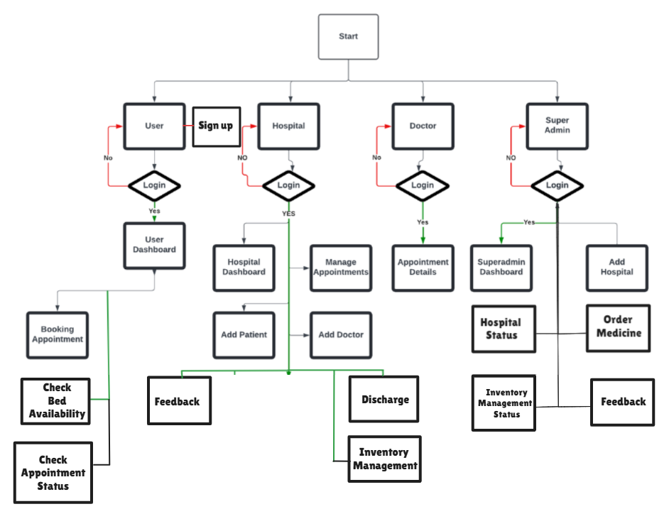
FLOW CHART

Slide 8
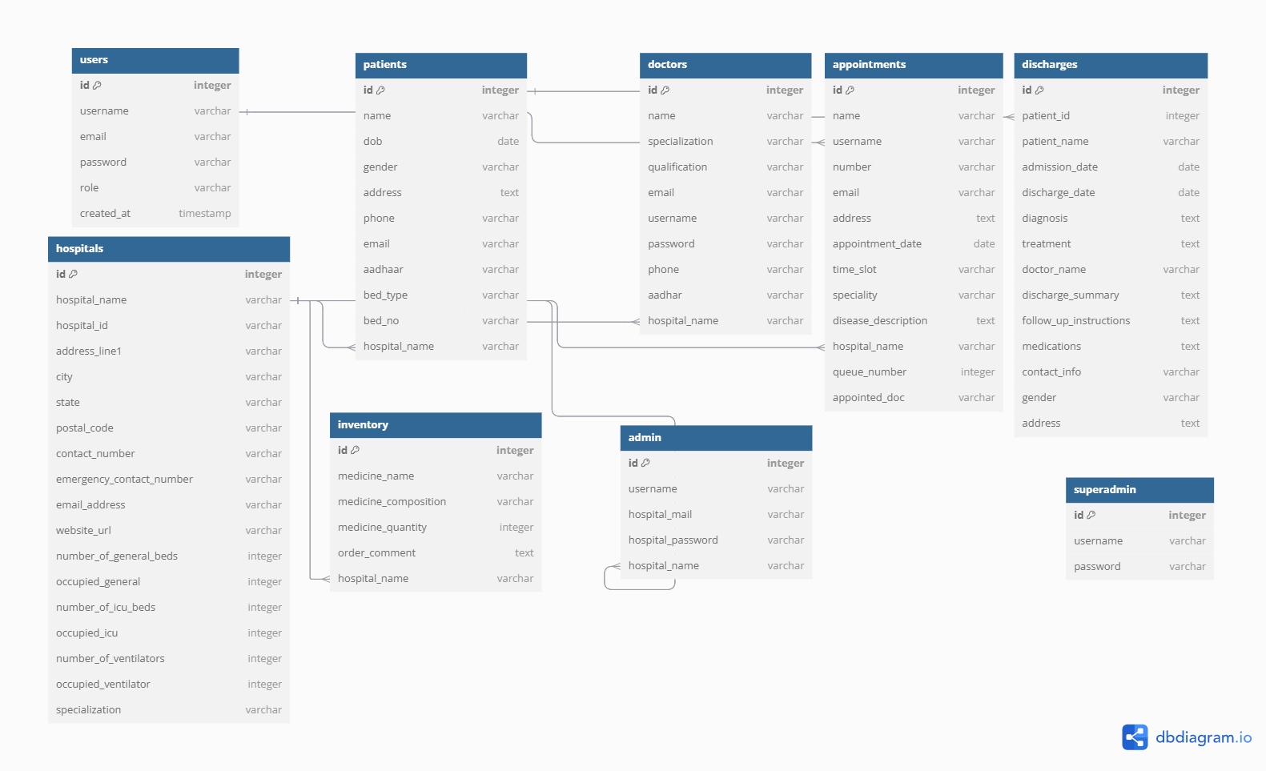
ER DIAGRAM

Slide 9
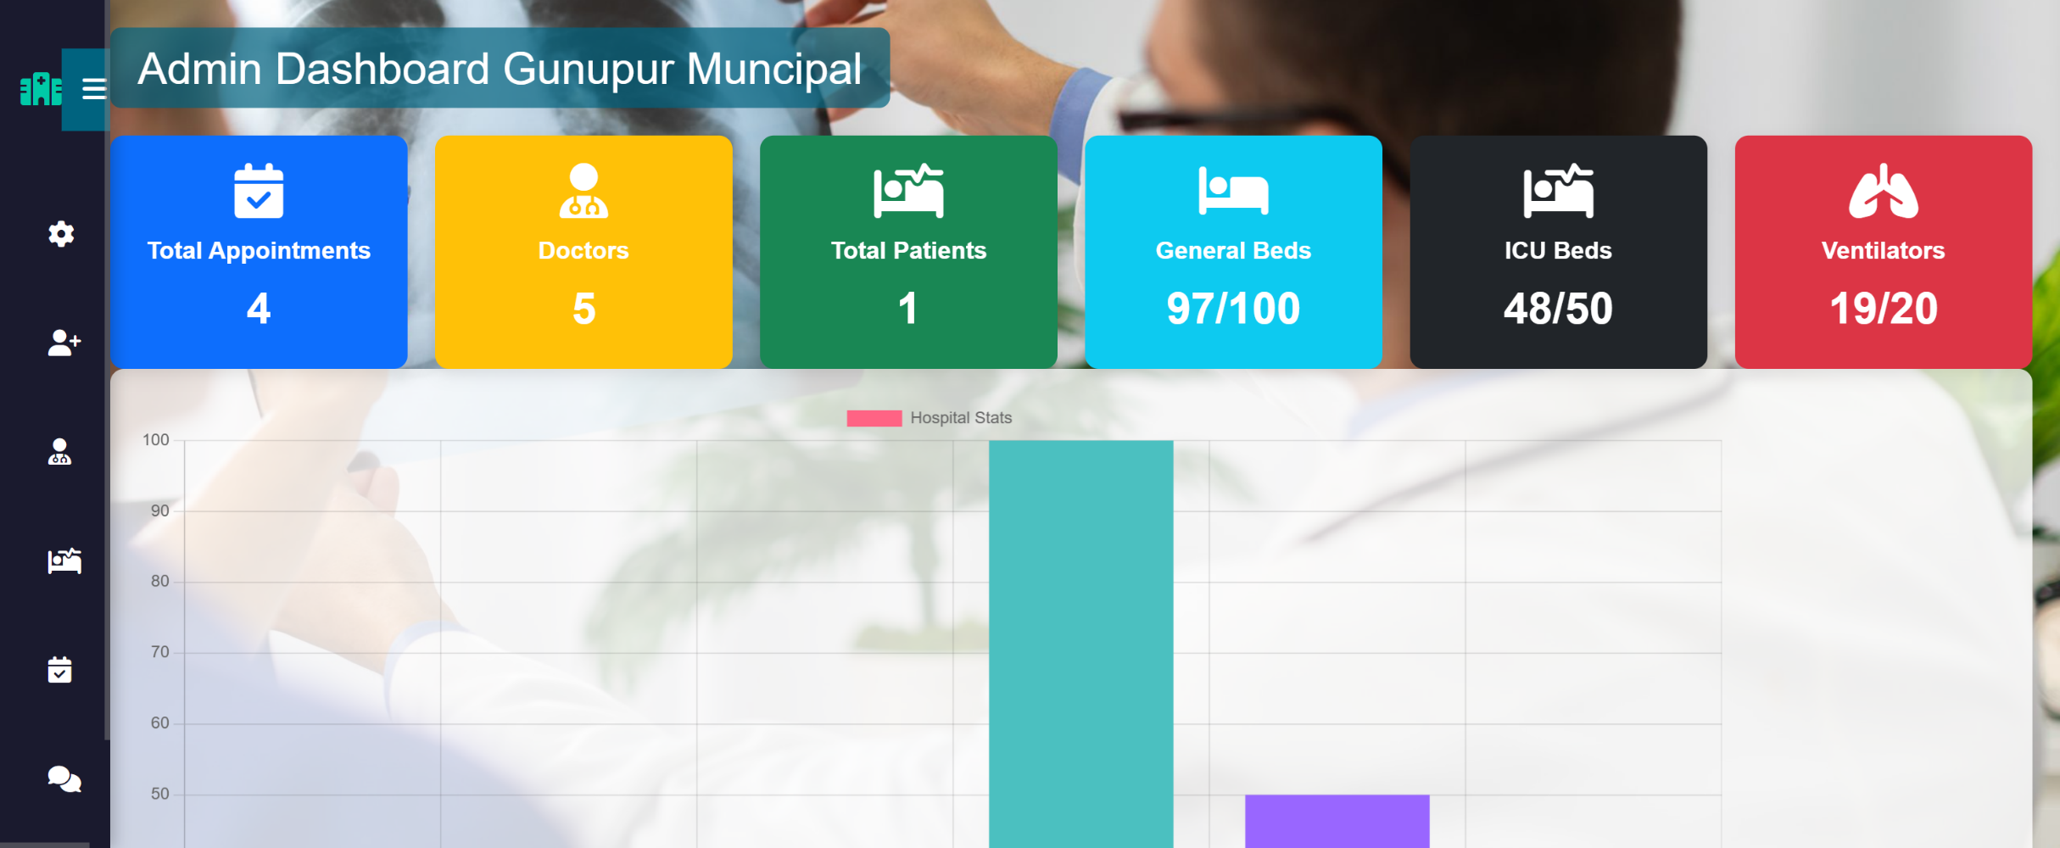
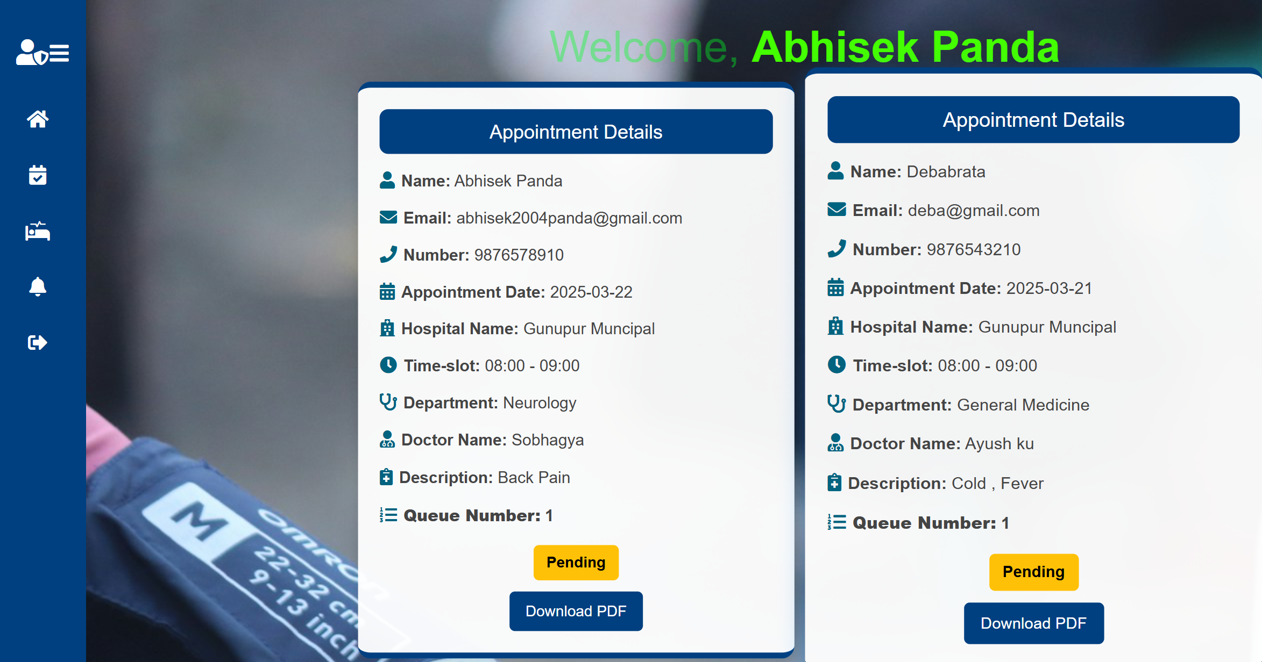
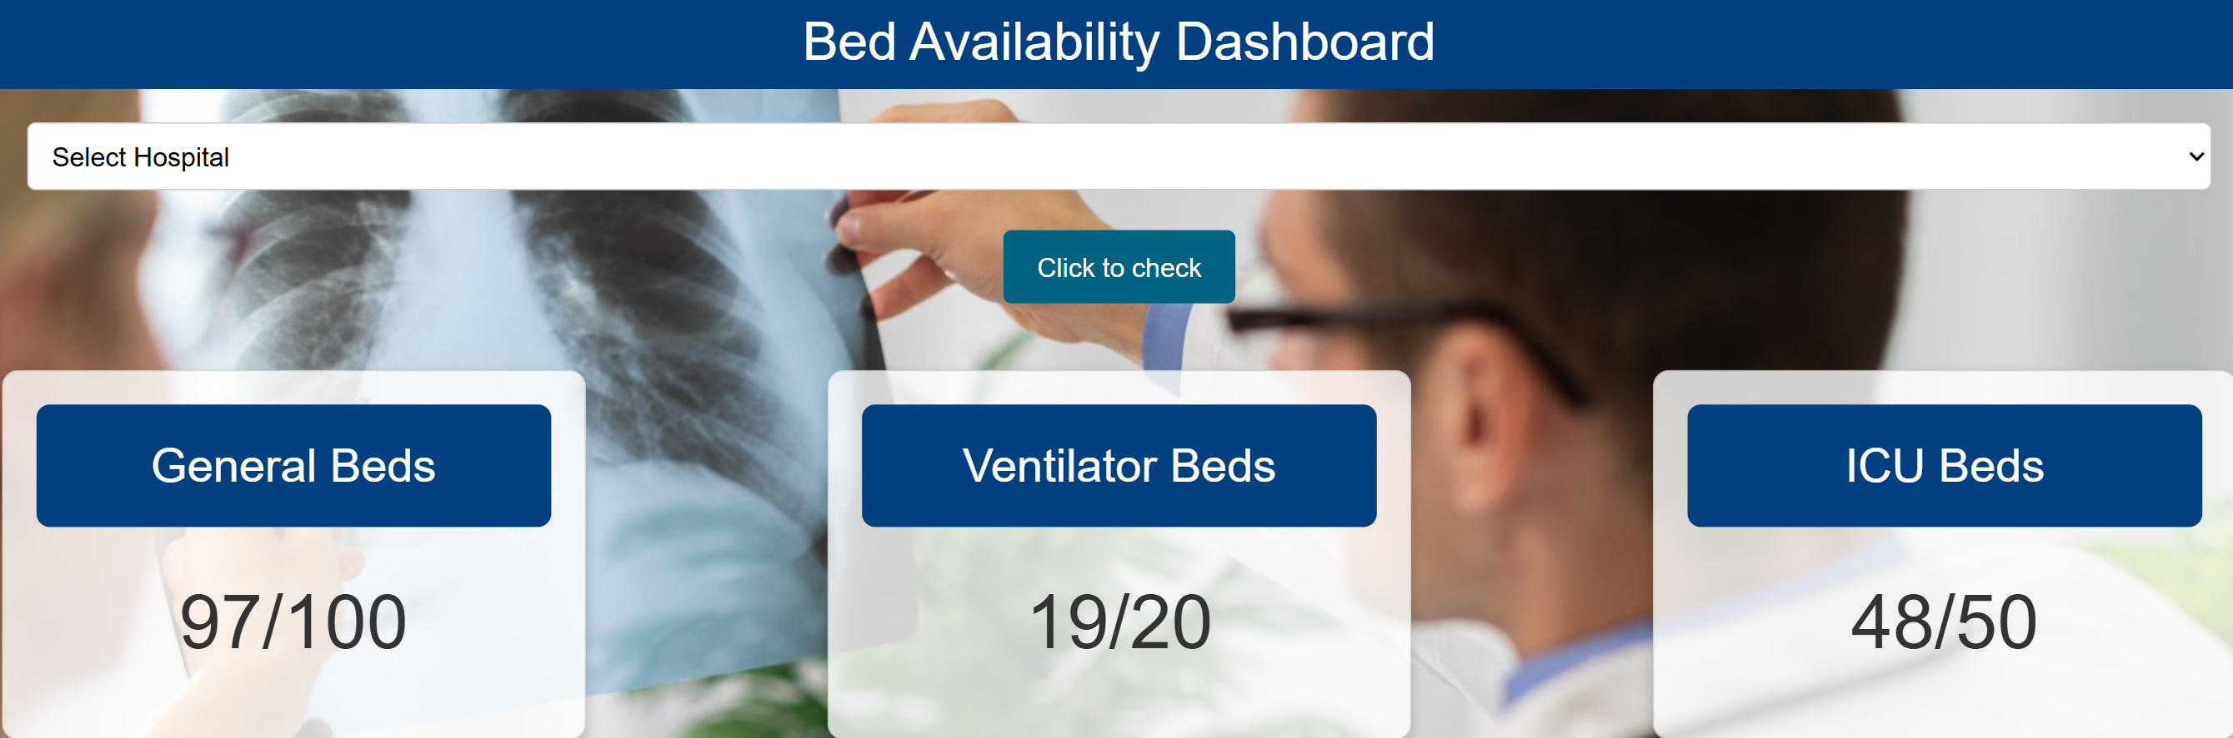
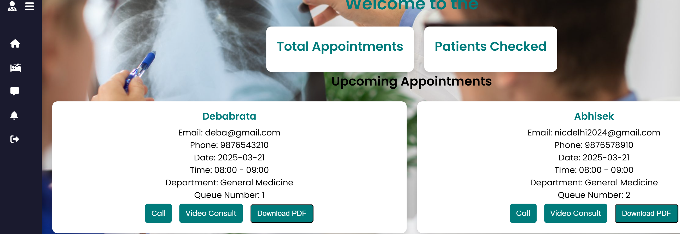
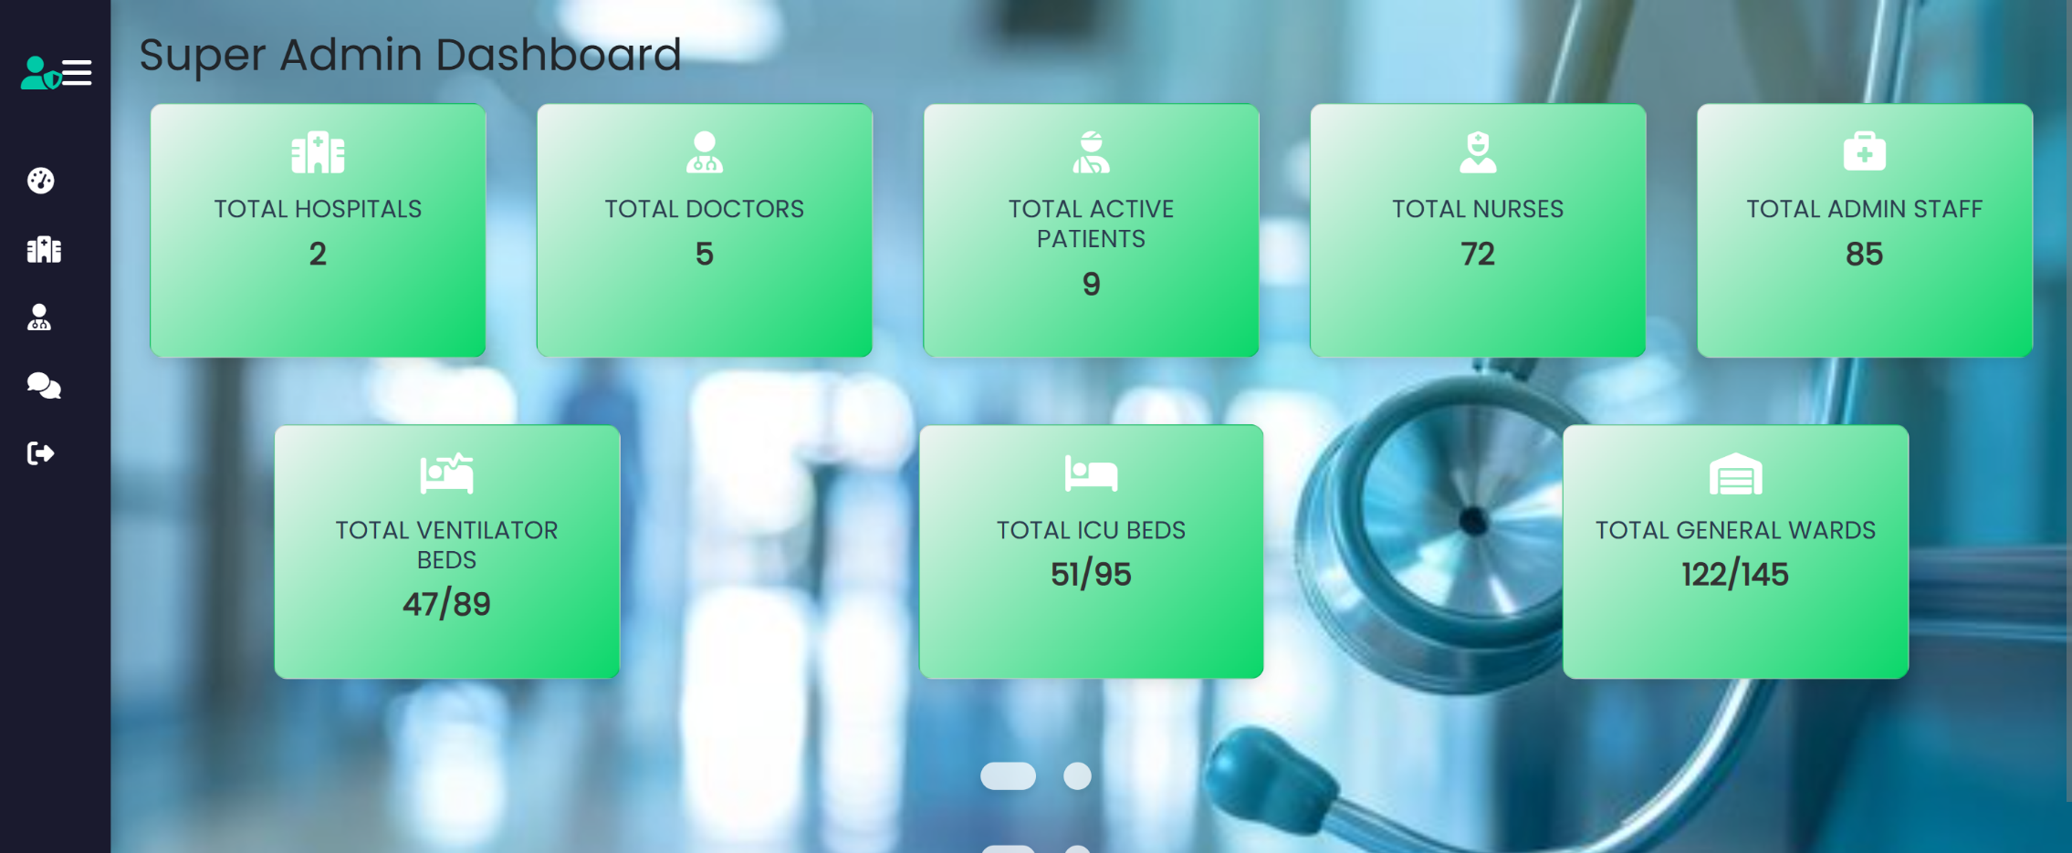
SCREENSHOT

Slide 10

Telemedicine Portal – Developing a virtual consultation platform to allow patients to connect with doctors remotely, making follow-ups, prescriptions, and non-critical consultations more accessible
1
Blood Bank Management System – Integrating a real-time blood bank tracking system where hospitals can update, request, and manage blood unit availability, ensuring faster access during emergencies. 🩸📊
2
📌 FUTURE SCOPE

Slide 11

A robust technological solution that addresses queuing models, bed availability, admission processes, and inventory management will significantly enhance hospital efficiency and patient care. Integration with city-wide modules will further ensure that hospitals can effectively coordinate with other healthcare providers, improving overall healthcare delivery.
This innovative hospital management system transforms healthcare by making it faster, smarter, and more efficient, ensuring better patient outcomes and seamless hospital operations.
CONCLUSION

Slide 12


22CSE072 ABHISEK - 9078089401
22CSE140 DEBABRATA - 9348179664
22CSE224 DIPTESH - 9556185722

